Slide 1
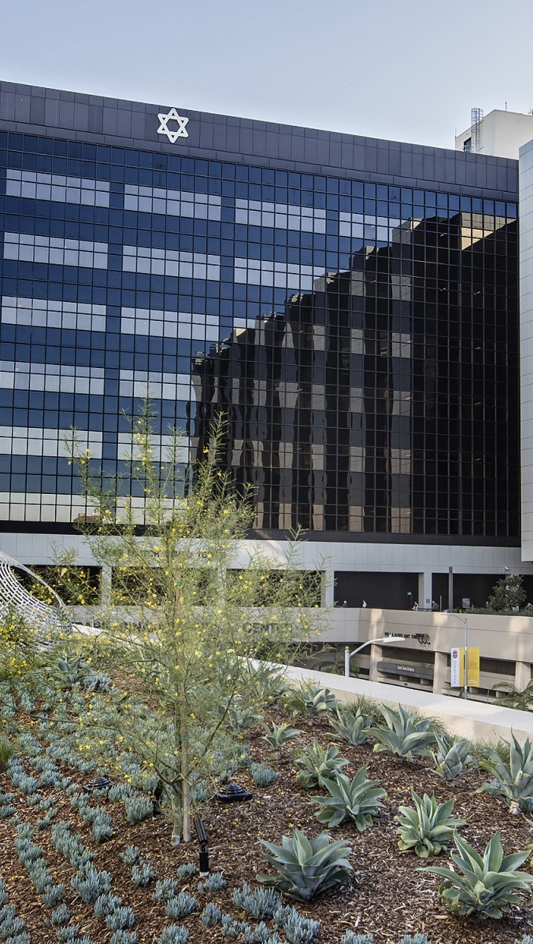


OPPORTUNITY REVIEW
DIRECT-TO-EMPLOYER GTM STRATEGY
Exploring a CSHS DTE Health Plan

Slide 2


Founded in 1979, headquartered in Indianapolis
Largest Independently-Owned Full-Service Third-Party Administrator
Specialize in Administration of Self-Funded Plans and Population Health Management​
Leader in the Direct-to-Employer Movement
We Know and Understand the Market
Experience Working with All Professional Teams: Agents, Networks, MGAs
The Key Family of Companies is a Vertically Integrated group of benefit related organizations
3,000+ Corporate Clients
3 Million Members under Management
700 Employees

Slide 3


MARKET LEADER
IN
PRIVATE LABELED
DTE PLANS
Louisville, KY
OneHealth Plan
Cincinnati, OH
TCH Optimal
Bentonville, AR
Northwest Health Plan
Knoxville, TN
East Tennessee Health Plan
Meridian, MS
Affinity Health Plan
Fort Myers, FL
Lee Health Care Partners

Slide 4

DIRECT-TO-EMPLOYER STRATEGY: ONLY AVAILABLE TO PREMIER HEALTH SYSTEMS
STRONG Brand Quality
EXTENSIVE Patient Access
AFFORDABLE Value Pricing
EXCELLENT Care Quality

Slide 5
CSHS IS PATIENT RECOMMENDED
Health System | HCAHPS Recommendation Percentile | CMS Stars Percentile | Mortality Percentile | Readmission Percentile | KBA Brand Quality Score
Cedars-Sinai Health System | 78 | 90 | 63 | 63 | 71
Providence St Joseph Health | 67 | 81 | 81 | 60 | 68
Kaiser Permanente | 57 | 66 | 60 | 41 | 64
PIH Health | 54 | 62 | 69 | 52 | 63
Henry Mayo Newhall Hospital | 46 | 60 | 63 | 55 | 63
MemorialCare Health System | 54 | 31 | 62 | 68 | 63
Keck Medicine of USC | 55 | 81 | 75 | 60 | 63
University of California Health | 51 | 61 | 73 | 63 | 62
HCA Healthcare | 50 | 60 | 93 | 50 | 61
CommonSpirit Health | 33 | 67 | 68 | 59 | 56
Adventist Health | 33 | 63 | 77 | 53 | 56
Based on quality measures and HCAHPS feedback, KBA estimates that CSHS has the strongest brand quality in Los Angeles, Orange, and Ventura Counties.

Slide 6
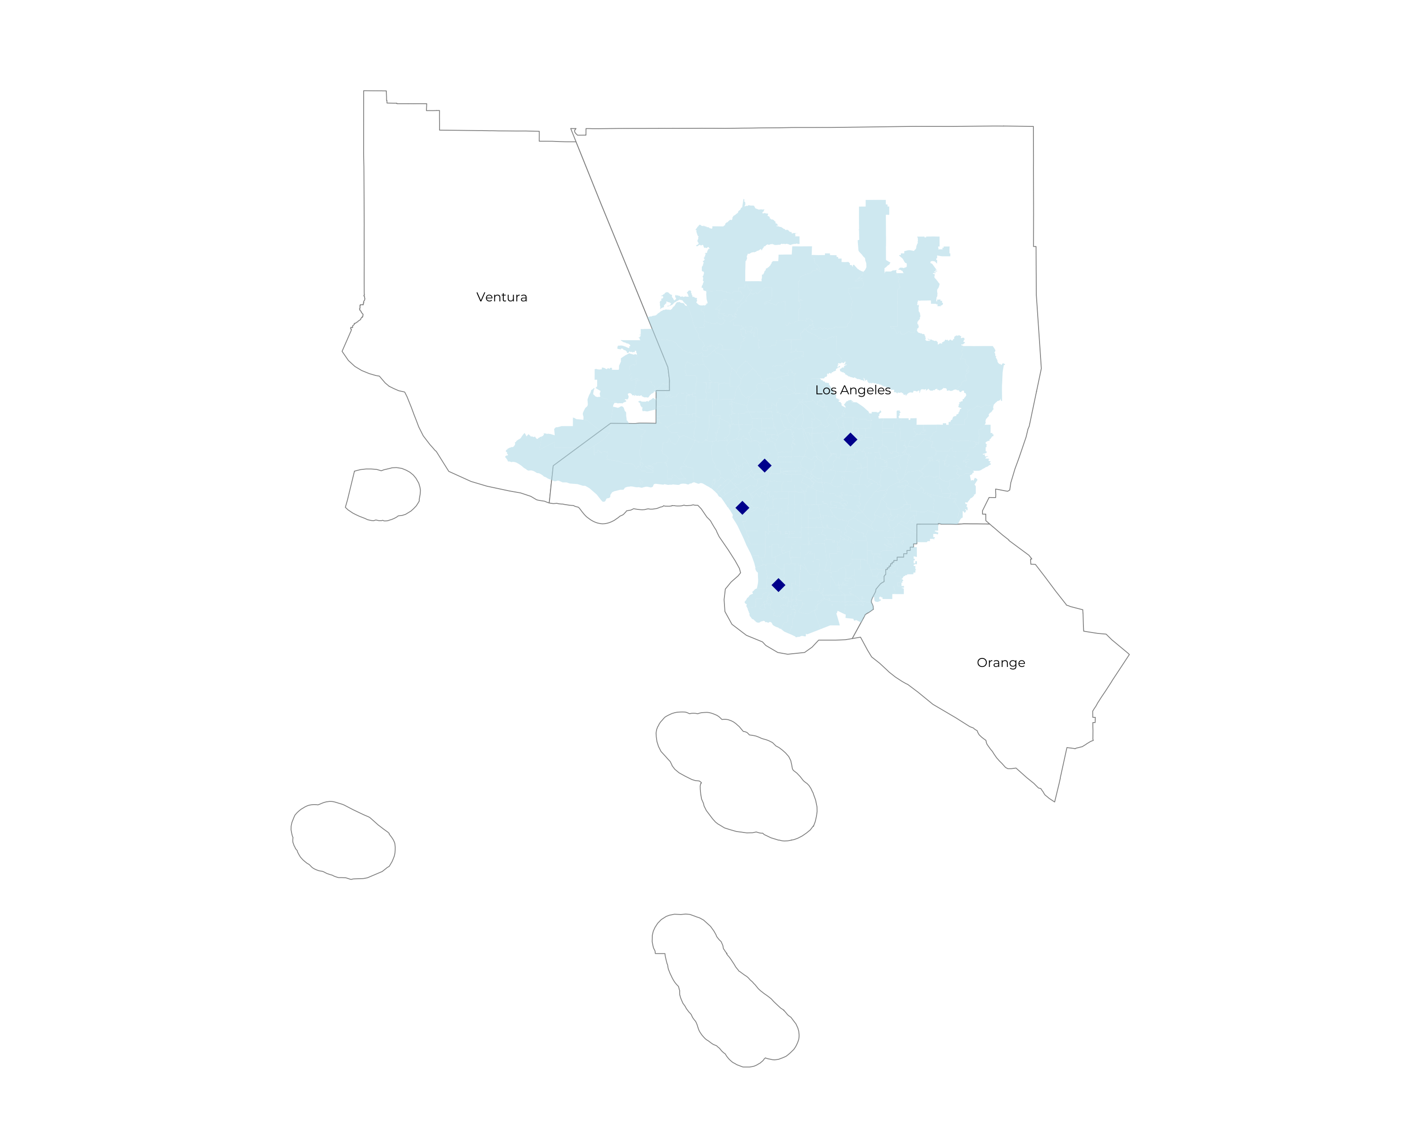
SIGNIFICANT OPPORTUNITY FOR PLAN GROWTH Researched for the below highlighted service area
Target Market 3.5K+ Employers 1.5M+ Employees 3M+ Members
 | Employer Size Group (# of Employees)
Commercial Employers With Headquarters | 50-100 | 101-200 | 201-400 | 401-1,000 | 1,001-3,000 | 3,000+
In Catchment Area | 9,220 | 4,030 | 2,498 | 1,363 | 414 | 218
Total Employees at Employers | 50-100 | 101-200 | 201-400 | 401-1,000 | 1,001-3,000 | 3,000+
Headquartered in Catchment Area | 691,500 | 604,500 | 749,400 | 954,100 | 828,000 | 1,308,000
Total Members with Employers | 50-100 | 101-200 | 201-400 | 401-1,000 | 1,001-3,000 | 3,000+
Headquartered in Catchment Area | 1,244,700 | 1,088,100 | 1,348,900 | 1,717,400 | 1,490,400 | 2,354,400

Slide 7
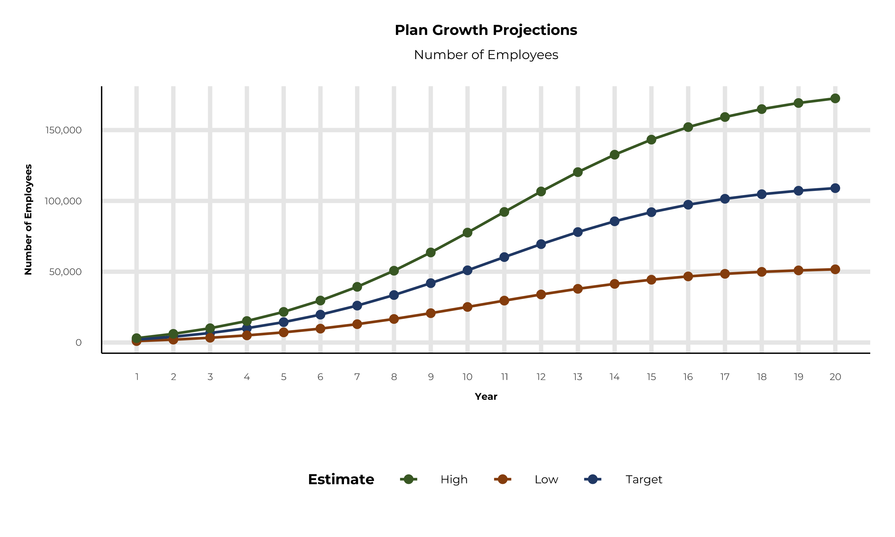
PLAN POTENTIAL GROWTH PATHS
Self Funded
1,494K
Insured
3,881K
Working Age
6,189K
Population
9,845K
Estimates includes the Cedars-Sinai Health System service area in Los Angeles, Orange, and Ventura Counties

Slide 8
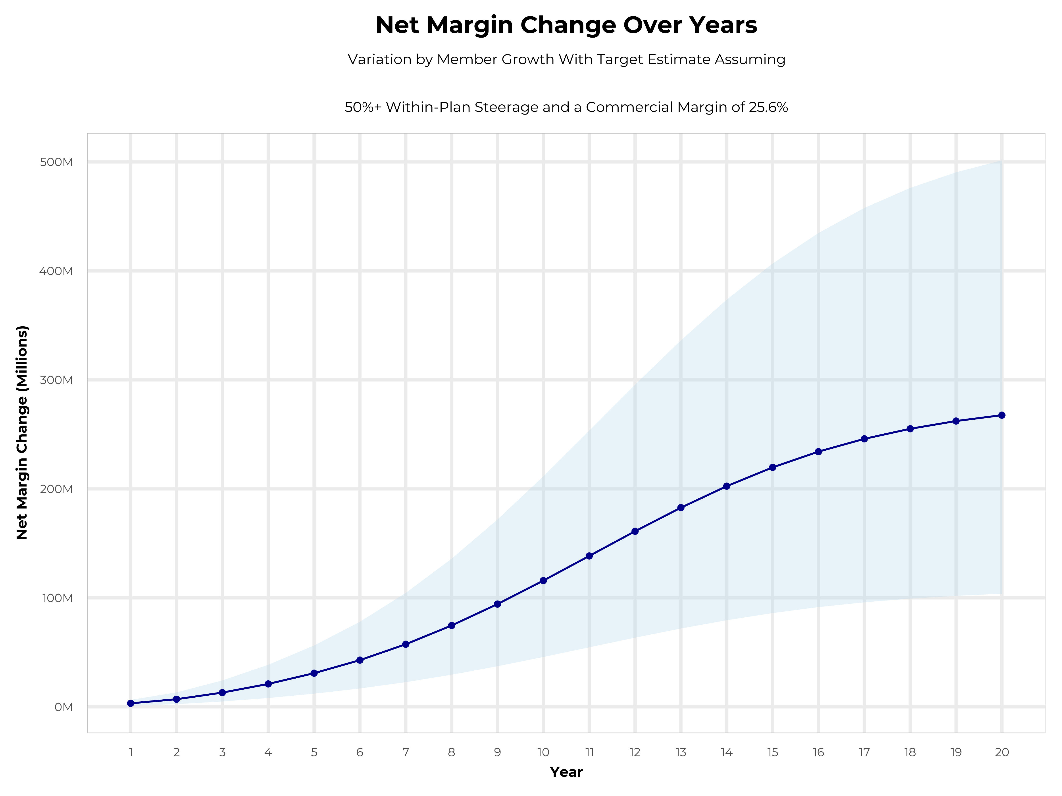
GROWING POWERFUL, LASTING PROFITABILITY
Early Stage
Gaining Name Recognition, Early Growth
New Revenue:
New Profit:
$76.91M
$19.71M
Growth Stage
Strong Reputation, Strong Growth
New Revenue:
New Profit:
$456.11M
$117.82M
Mature Stage
High Profitability, Market Saturation
New Revenue:
New Profit:
$933.03M
$241.07M

Slide 9
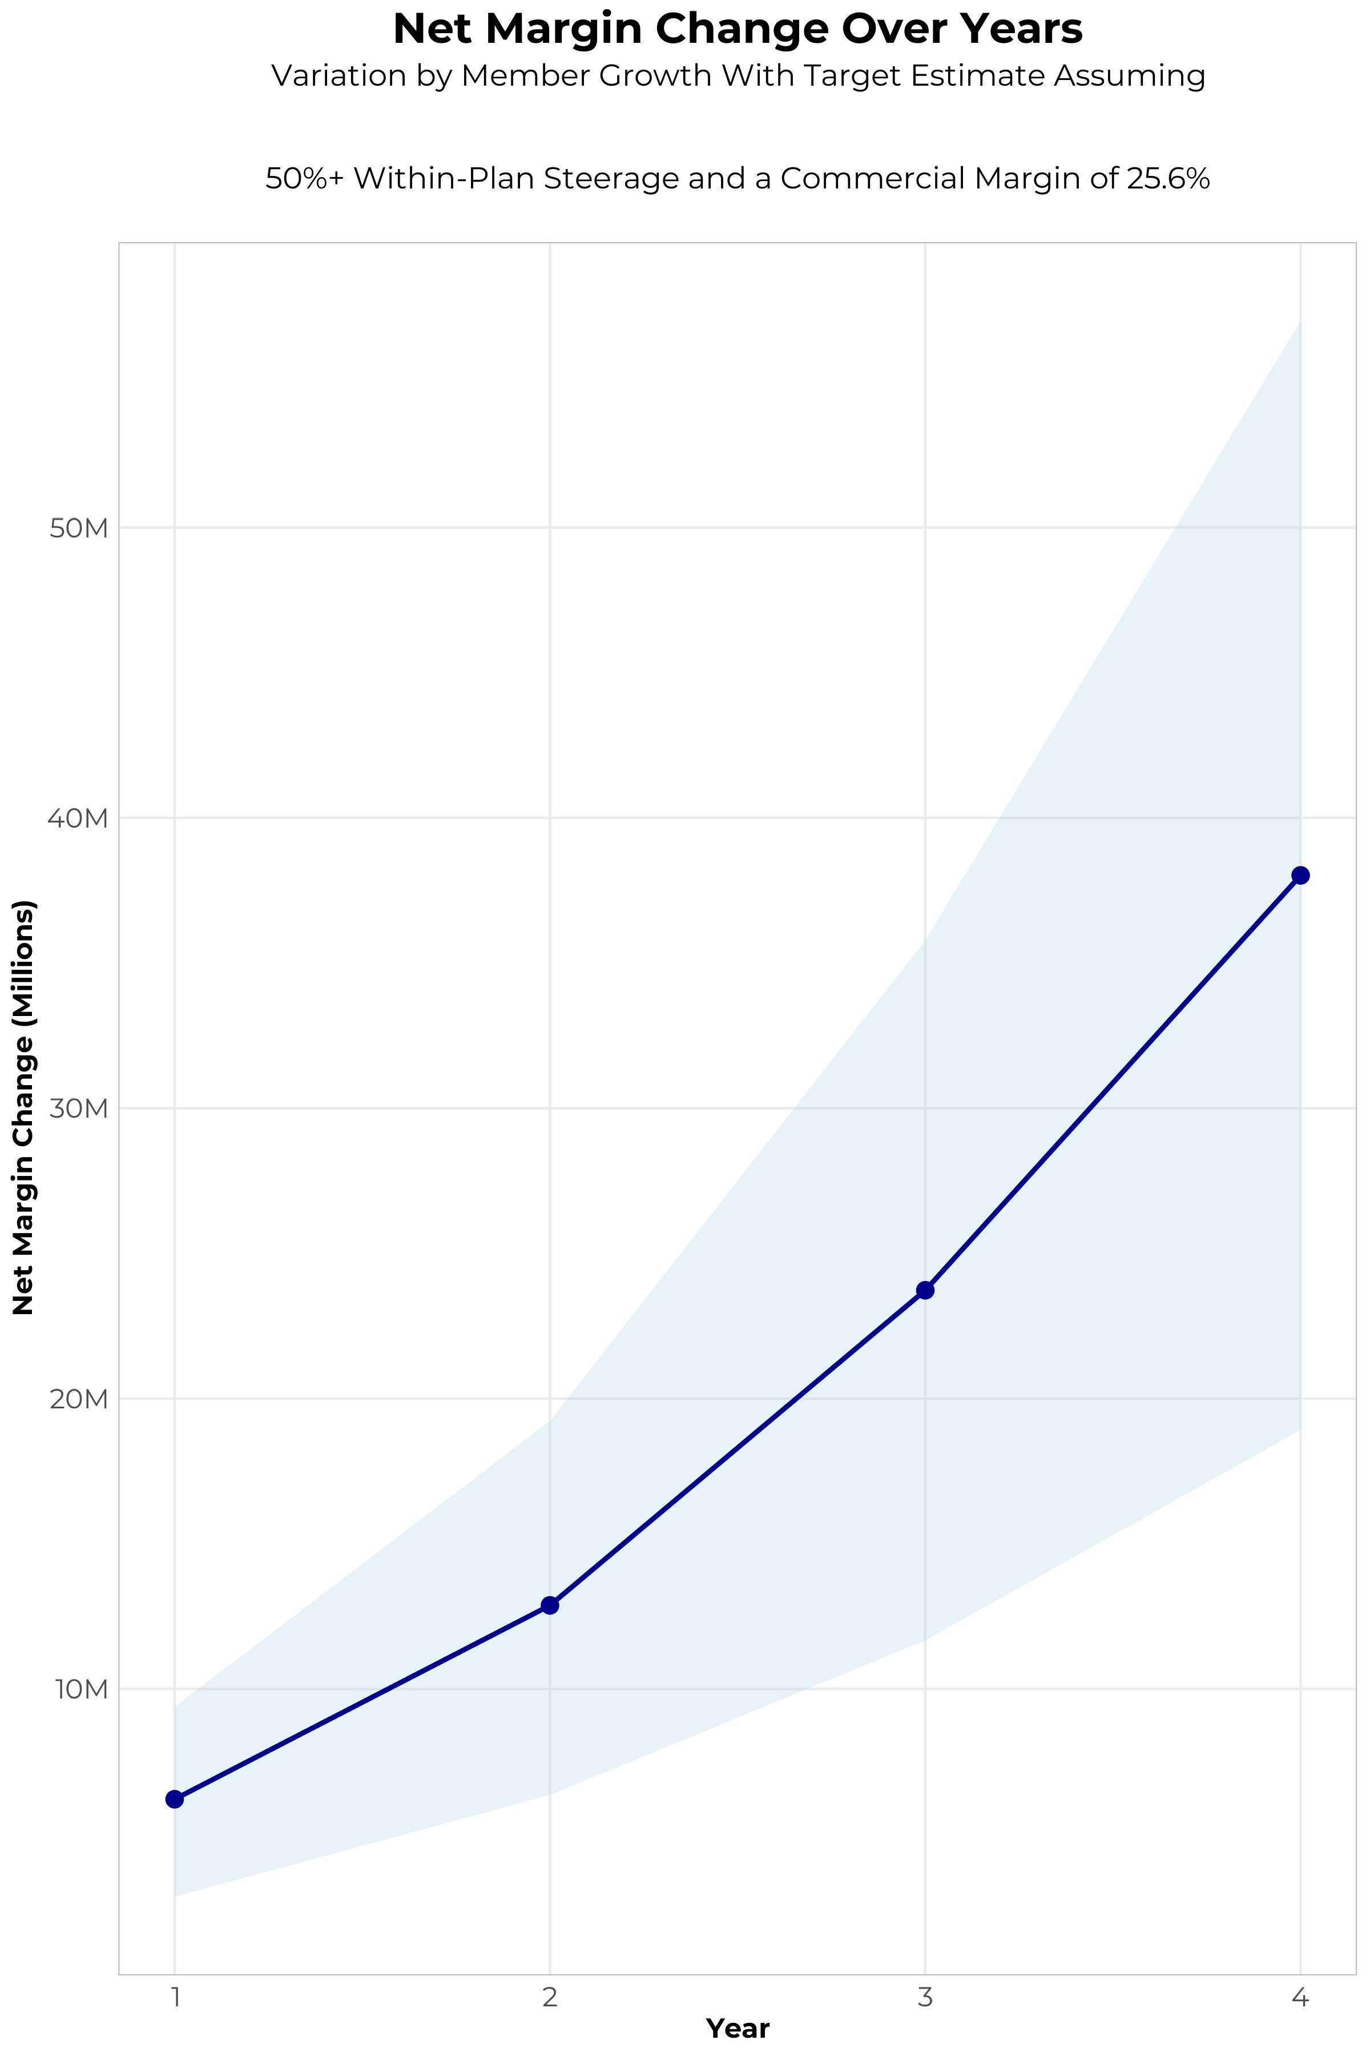
FOUR-YEAR PROJECTIONS
Target Member Growth | Target Member Growth | Target Member Growth | Target Member Growth | Target Member Growth
Metric | Year 1 | Year 2 | Year 3 | Year 4
Number of Members | 3,700 | 7,400 | 12,100 | 18,200
Incremental Margin | 6,486.6K | 12,969.0K | 23,765.2K | 37,982.0K
Network Access Fee | 44.4K | 88.8K | 145.2K | 218.4K
Implementation Fee (One-Time) | -150.0K | 0.0K | 0.0K | 0.0K
Sales and Marketing Costs | -180.0K | -180.0K | -180.0K | -180.0K
Net Margin Change | 6,201.0K | 12,877.8K | 23,730.4K | 38,020.4K
High Member Growth | High Member Growth | High Member Growth | High Member Growth | High Member Growth
Metric | Year 1 | Year 2 | Year 3 | Year 4
Number of Members | 5,500 | 11,000 | 18,200 | 27,300
Incremental Margin | 9,642.2K | 19,278.2K | 35,746.1K | 56,973.0K
Network Access Fee | 66.0K | 132.0K | 218.4K | 327.6K
Implementation Fee (One-Time) | -150.0K | 0.0K | 0.0K | 0.0K
Sales and Marketing Costs | -180.0K | -180.0K | -180.0K | -180.0K
Net Margin Change | 9,378.2K | 19,230.2K | 35,784.5K | 57,120.6K
Low Member Growth | Low Member Growth | Low Member Growth | Low Member Growth | Low Member Growth
Metric | Year 1 | Year 2 | Year 3 | Year 4
Number of Members | 1,800 | 3,700 | 6,000 | 9,100
Incremental Margin | 3,155.6K | 6,484.5K | 11,784.4K | 18,991.0K
Network Access Fee | 21.6K | 44.4K | 72.0K | 109.2K
Implementation Fee (One-Time) | -150.0K | 0.0K | 0.0K | 0.0K
Sales and Marketing Costs | -180.0K | -180.0K | -180.0K | -180.0K
Net Margin Change | 2,847.2K | 6,348.9K | 11,676.4K | 18,920.2K

Slide 10
PROJECTED PLAN GROWTH
Year | Employees | Members | Percent of Members Choosing CSHS for Inpatient Care | Percent of Members Choosing CSHS for Outpatient Care
1 | 2,000 | 3,600 | 60% | 50%
2 | 4,100 | 7,400 | 60% | 50%
3 | 6,700 | 12,100 | 65% | 55%
4 | 10,100 | 18,200 | 67% | 58%
5 | 14,400 | 25,900 | 68% | 60%
6 | 19,700 | 35,500 | 68% | 60%
7 | 26,100 | 47,000 | 69% | 61%
8 | 33,500 | 60,300 | 69% | 62%
9 | 41,900 | 75,400 | 69% | 62%
10 | 51,000 | 91,800 | 70% | 63%
11 | 60,300 | 108,500 | 70% | 63%
12 | 69,500 | 125,100 | 70% | 64%
13 | 78,000 | 140,400 | 71% | 64%
14 | 85,600 | 154,100 | 71% | 65%
15 | 92,000 | 165,600 | 71% | 66%
16 | 97,300 | 175,100 | 72% | 66%
17 | 101,500 | 182,700 | 72% | 66%
18 | 104,700 | 188,500 | 72% | 67%
19 | 107,200 | 193,000 | 72% | 67%
20 | 109,000 | 196,200 | 72% | 67%
KBA currently estimates that Cedars-Sinai Health System has 19% inpatient market share, and 10% outpatient market compared to hospitals/clinics in the Cedars-Sinai Health System service area (see slide 8).
Based on previous DTE experience, KBA expects a significant bump in patient steerage to Cedars-Sinai Health System.
Additional steerage will occur from additional steerage patient benefits and the patient card.
High estimates start nearly 10% higher than target with low estimates at 10% lower than target

Slide 11
YEAR 4 PROJECTED REVENUE AND PROFIT
Pre-DTE Cohort of 18,200 Employees | Inpatient | Outpatient | Professional | Total
Revenue† | $ 16,283,925 | $ 15,492,477 | $ 7,234,855 | $ 39,011,257
Net Income‡ | $ 4,168,685 | $ 3,966,074 | $ 1,852,123 | $ 9,986,882
† Assuming proportional revenues from market shares of 19% (inpatient) and 10% (outpatient)
‡ Conservatively assuming a commercial margin of 25.6% (80% of the estimated commercial margin)
With DTE | Inpatient | Outpatient | Professional | Total
Revenue⁰ | $ 56,515,180 | $ 88,623,572 | $ 41,386,455 | $ 186,525,206
Net Income* | $ 14,467,886 | $ 22,687,634 | $ 10,594,932 | $ 47,750,453
⁰ Assuming 67% inpatient and 58% market steerage based on KBA narrow network DTE experience (see previous slide)
* Conservatively assuming a commercial margin of 25.6%, with a 10 percentage-point reduction to reflect competitive-edge rates and a 10 percentage-point increase due to lower billing costs and higher patient responsibility collections because of the member credit card.
Total Increase in Net Income | $ 37,763,571
Network Access Fee (Revenue) of $1 PMPM | $ 218,400
Total Profit Growth | $ 37,768,371
Minus Implementation Fee (One-Time) | -$ 0
Minus Sales and Marketing (Annual – Ongoing) | -$ 180,000
Total | $ 37,801,971

Slide 12

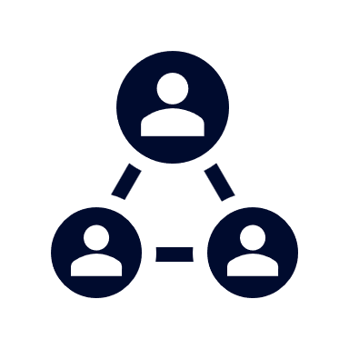



A PARTNER YOU CAN TRUST
OUR OBJECTIVES ARE ALIGNED
WE KNOW THE
MARKET
COMPLETELY TRANSPARENT
WE HAVE THE SOPHISTICATION AND INFRASTRUCTURE TO EFFECTIVELY COMPETE
Derek Moore, Senior Vice President – KBA
845-283-9973 * derek.moore@keybenefit.com

